Slide 1
TRANSFORMER
DIGVIJAY
BSC 2ND YEAR (MATHS)
GOVT. NAVEEN COLLEGE GURUR

Slide 2
Transformer
CONTENT :-
What is transformer
2. Types of transformer
3. Structure & working processes of transformer
4. Use of Transformer

Slide 3
a. What is transformer
?

Slide 4
b. Types of transformer
Two types of transformer :-
1. Step down transformer
2. Step up transformer

Slide 5
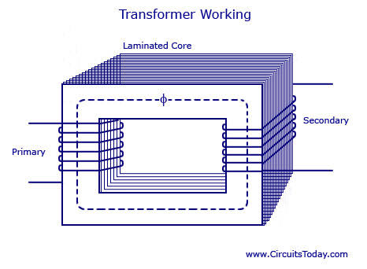
c. Structure & working processes of transformer
eEs/Ep = Np/Ns

Slide 6
d. Use's of transformer
2. Telephone
3. Television
4. Refrigerator
1.Radio set

Slide 7
Thanks you

