Slide 1
X-Ray
Priya
B.Sc. Final year
Govt. Naveen College Gurur
First presentation

Slide 2
X-Ray
Discovery of X-Ray
Introduction
Properties
Disadvantage
Use of X-Ray

Slide 3
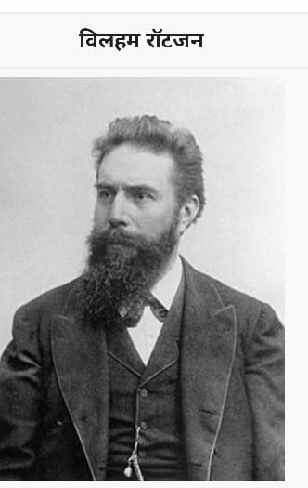
1 . Discovery of X-Ray -
Wilhelm Conrad Rontgen was a noble prize winner in physics of 1901. He was awarded this prize for discovery of X-Ray.
He discovered X-Ray on 1895.

Slide 4
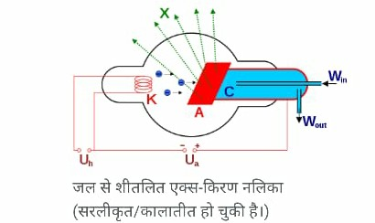
Introduction
X-Ray is a type of a electromagnetic radiation .
Which wavelength is lies on 10 – 0.01 nm . Its classical measurement unit is rontgen equivalent man(REM).

Slide 5
Properties
It has two specific quality –
Intensity
Permeablity in solid substance

Slide 6
Disadvantage
1. It is harmful to our eyes & body.
2. It causes of cancer.
3. It ruins cells of our body .

Slide 7
Use of X-Ray
In Treatment of cancer.
In testing of real diamonds .
In study of crystal structure of atoms
In reorgnizing lungs disease.
To determine cracking bones .

Slide 8
THANK YOU

