Slide 1
GOVT. NAVEEN COLLAGE GURUR NAME – CHANDRAVATI CLASS – B.Sc.(III) MATHEMATICS SUBJECT – PHYSICS SUB. TEACHER – MR. L.HIRWANI SIR
RADIOACTIVITY

Slide 2
RADIOACTIVITY
INTRODUCTION
DISCOVERY
TYPES
THE UNIT OF RADIOACTIVITY
USE OF RADIATION
EFFCT OF RADIATION

Slide 3
RADIOACTIVITY

Slide 4
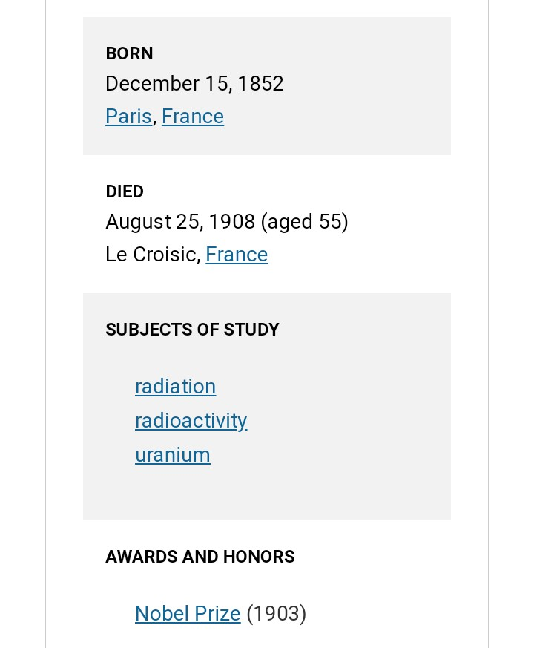
DISCOVERY:- HENRI BECQUEREL

Slide 6
DECAY

Slide 7
ALFA DECAY
BEETA DECAY
ELECTRON:- POJITRON:-
GAMA RADIATION

Slide 8
THE UNIT OF RADIOACTIVITY:-

Slide 9
USE OF RADIOACTIVITY:-

Slide 10
THANK YOU

