Slide 1
INTRODUCTION
NAME - HAMEMENDRA KUMAR RANBANKURE
CLASS – B.Sc. FINAL (MATHEMATICS)
Govt naveen college gurur

Slide 2
THE TIME DILATION
Origin and need of time dilation
Definition of time dilation
Examples of time dilation
Experimentally confirmation
Experimentally verification
Expression for time dilation
Graph
Application and uses of time dilation
Time dilation in black hole

Slide 3
Origin and need of time dilation
This so called “time dilation” effect is a consequence of Einstein’s theory of general relativity , which posits that the gravity of the massive body- such as the Earth –wrap the flow of time to speed up or slow down depending on its distance from the mass.
Joseph larmor ( 1897)
Hermann minkowski (1907)- introduced the concept of proper time.

Slide 4
Definition of time dilation
A slowing of time in accordance with the theory of relativity that occurs in a system in motion relative to an out side observer and that becomes apparent especially as the speed of the system approaches that of light called also time dilation .
Types of time dilation:-
Velocity time dilation
Gravitational time dilation

Slide 5
Examples of time dilation
An example of time dilation a spaceship is flying of five light hours for example from earth to the dwarf planet Pluto

Slide 6
Experimentally confirmation
In frame of reference in which the clock is not at rest, the clock runs more slowly, as expressed by the Lorentz factor, this effect called time dilation, has been confirmed in many tests of special relativity such as the ives Stilwell experiment and experimental testing of time dilation

Slide 7
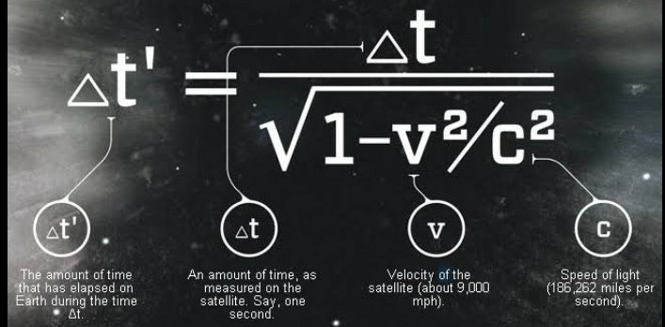
Expression for time dilation
Expression of time dilation is given by :-

Slide 8
Experimentally verification
µ-meson is a temporary basic particle which has 2.2*10⁻⁶ second average age at rest since speed of µ-meson will be less then speed of light c, so probable distance covered by it will be 2.2*10⁻⁶ *3*10⁸= 0.66 KM. namely generated meson in the upper part of the atmosphere shouldn’t arrive on earth surface as the distance of the atmosphere from the earth plane is about 10 km. but it is found by experiment at high speed of µ-meson:-
V=0.999c then median speed of µ-meson

Slide 9
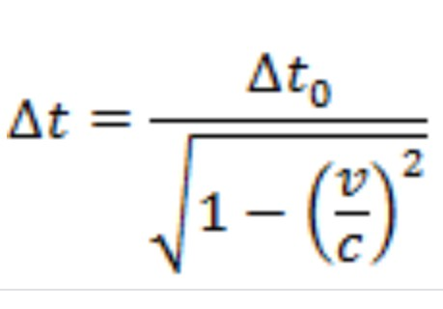
By using formula of time dilation
=
= 6.6*10⁻⁵ second
Distance covered by it = 6.6*10⁻⁵ *0.999c
= 20 km

Slide 10
Graph

Slide 11
Application and uses of time dilation
The theory explains the behavior of objects in space and time.
To predict everything from the existence of black holes.
Explanation of light bending due to gravity.
Time determination and positioning in G.P.S.
Behavior of the planet mercury in its orbit.

Slide 12
Application of time dilation
time determination in GPS-
GPS is affected by special relativity because the satellites used travel in high speed orbits around the earth special relativity sows that a faster moving object will experience time slower relative to a stationary object for GPS satellites this sight difference in time is around 7.2 microseconds per day.

Slide 13
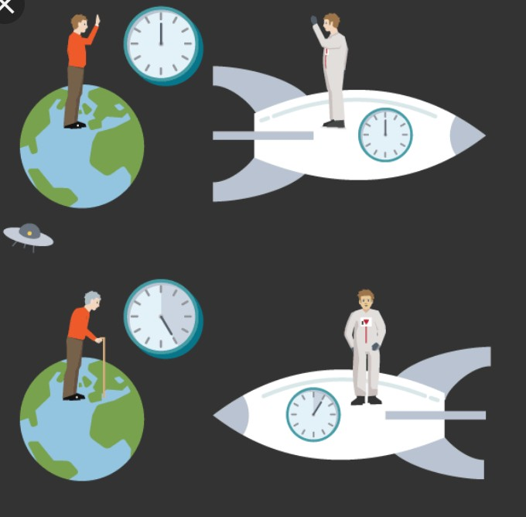
Twin paradox
The apparent paradox arising from relativity theory that if one of a pair of twins makes a long journey at near the speed of light and then returns he or she will have aged less than the twin who remains behind.

Slide 14
Time dilation in black hole
To a distant observer, clock near a black hole would appear to tick more slowly than those further away from the black hole . Due to this effect known as gravitational time dilation , an object falling into a black hole appear to as it approaches the event horizon, talking an infinite time to reach it.

Slide 15
Thank You

